Slide 1
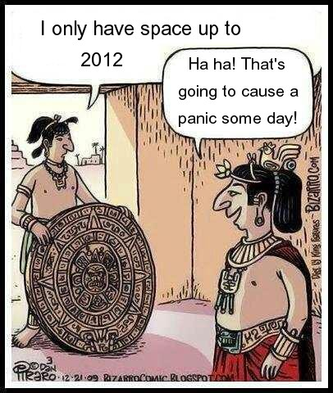
The End of the World!
GICF RETREAT
Saturday, January 12th
(unless the world ends first)
Sign up today (10 RMB per head)

Slide 2
A Baby for a Bad Guy
Notes:
Andrew comes on stage. I want to swap him for someone… Let’s see… name a couple of good ones, then say ‘that bad guy in the back row’. Worth it? Mum approve? What would you think when you see this little boy? Can he save the world? (NO!) What might by standers have thought when they saw Jesus as a baby? Let’s see today.

Slide 3
Who have you come to see?
Today’s readings
Jesus, born of a virgin (Matthew 1:18-24, Luke 2:1-7 )
He was God eternal, born as a human baby (John 1:1-5, Luke 2:8-20)
He was recognised by some (Luke 2:25-40) but would be hated by others
Notes:
But let’s look at the last passage to see what some saw in the baby Jesus

Slide 4
Simeon
Luke 2:25-35 Waiting for the consolation of Israel
“I have seen …
‘YOUR SALVATION’
‘A light’
‘the glory of your people’”
“Destined for the fall and rise of many … that the thoughts of many hearts may be revealed”
What does your heart think of Christ? Is He really worth living for?

Slide 5
Anna
Luke 2:36-40 Prophetess waiting with fasting and prayer
“Thank you, God”
“Redemption has come” (Spoke of him to all those who looked for redemption in Jerusalem

Slide 6
Wise men Matthew 2:1-16
1. Now when Jesus was born in Bethlehem of Judaea in the days of Herod the king, behold, there came wise men from the east to Jerusalem, 2. Saying, Where is he that is born King of the Jews? for we have seen his star in the east, and are come to worship him. … 11. And when they were come into the house, they saw the young child with Mary his mother, and fell down, and worshipped him: and when they had opened their treasures, they presented unto him gifts; gold, and frankincense, and myrrh. … 16 Herod … slew all the children that were in Bethlehem, and in all the coasts thereof, from two years old and under, according to the time which he had diligently enquired of the wise men.

Slide 7
Wise men
Matthew 2:1-16 Seeking for a long time
He who has been born King of the Jews (now about 2 years old)
We have seen his star
We have come to worship him
(Gave HIM gifts in the house)

Slide 8
CONCLUSION
I have seen the light – I have received His salvation and am showing his glory by belonging to his people (the body of Christ)
HAVE YOU?
2. I tell others of his redemption
HAVE YOU?
3. I have come to worship him (bringing my gifts & adoration)
HAVE YOU?
4. Would you swap this baby for the whole world? His Father did! We MUST NOT! When a new baby comes into the home, everything changes. So, too, when this ‘baby become a man’ comes into your life. Everything must change to please Him – the great King. Wise men still seek him!

Slide 9
Question of the year: Are you living an authentic Christian life?
Authentic Christian Living
= Living a life of worship and service to the King from a heart full of love and thanks for having received salvation and redemption
Accepting the swap - a baby for a bad guy.

